Slide 1


Introduction to Cybersecurity
Introduction
ILIA STATE UNIVERSITY
Paata Gogishvili
Doctor of Informatics
Associate Professor
School of Technology
September 26, 2023
Faculty of Business, Technology and Education

Slide 2
Lecture Topics
Information Security vs Cybersecurity
Terms: Active threat, Vulnerability, Risk
CIA
Risk Identification and Estimation
ILIA STATE UNIVERSITY

Slide 3
INFORMATION SECUIRITY vs CYBERSECURITY
Information security and cybersecurity are two terms that are often used interchangeably, but they have different meanings.
Information security refers to the protection of information from unauthorized access, use, disclosure, disruption, modification, or destruction, regardless of the medium in which it is stored. Cybersecurity, on the other hand, is a subset of information security that focuses specifically on the protection of information from cyber threats, which are threats that use the Internet, networked systems, or other forms of electronic communication to exploit vulnerabilities in information systems.
ILIA STATE UNIVERSITY

Slide 4
INFORMATION SECUIRITY - Definition
Various definitions of information security are suggested below, summarized from different sources:
1. "Preservation of confidentiality, integrity and availability of information. Note: In addition, other properties, such as authenticity, accountability, non-repudiation and reliability can also be involved." (ISO/IEC 27000:2009)
2. "The protection of information and information systems from unauthorized access, use, disclosure, disruption, modification, or destruction in order to provide confidentiality, integrity, and availability." (CNSS, 2010)
3. "Ensures that only authorized users (confidentiality) have access to accurate and complete information (integrity) when required (availability)." (ISACA, 2008)
4. "Information Security is the process of protecting the intellectual property of an organisation." (Pipkin, 2000)
ILIA STATE UNIVERSITY

Slide 5
INFORMATION SECUIRITY - Definition
5. "...information security is a risk management discipline, whose job is to manage the cost of information risk to the business." (McDermott and Geer, 2001)
6. "A well-informed sense of assurance that information risks and controls are in balance." (Anderson, J., 2003)
7. "Information security is the protection of information and minimizes the risk of exposing information to unauthorized parties." (Venter and Eloff, 2003)
ILIA STATE UNIVERSITY

Slide 6
INFORMATION SECUIRITY - Definition
8. "Information Security is a multidisciplinary area of study and professional activity which is concerned with the development and implementation of security mechanisms of all available types (technical, organizational, human-oriented and legal) in order to keep information in all its locations (within and outside the organization's perimeter) and, consequently, information systems, where information is created, processed, stored, transmitted and destroyed, free from threats. Threats to information and information systems may be categorized and a corresponding security goal may be defined for each category of threats. A set of security goals, identified as a result of a threat analysis, should be revised periodically to ensure its adequacy and conformance with the evolving environment. The currently relevant set of security goals may include: confidentiality, integrity, availability, privacy, authenticity & trustworthiness, non-repudiation, accountability and auditability." (Cherdantseva and Hilton, 2013)
ILIA STATE UNIVERSITY

Slide 7
INFORMATION SECUIRITY - Definition
9. Information and information resource security using telecommunication system or devices means protecting information, information systems or books from unauthorized access, damage, theft, or destruction (Kurose and Ross, 2010).
ILIA STATE UNIVERSITY

Slide 8

INFORMATION SECUIRITY - History
Since the early days of communication, diplomats and military commanders understood that it was necessary to provide some mechanism to protect the confidentiality of correspondence.
Julius Caesar is credited with the invention of the Caesar cipher circa 50 B.C. The principle of encoding was not very complicated. Today, the Caesar cipher and its decipherment is a classic example.
ILIA STATE UNIVERSITY
Julius Caesar

Slide 9
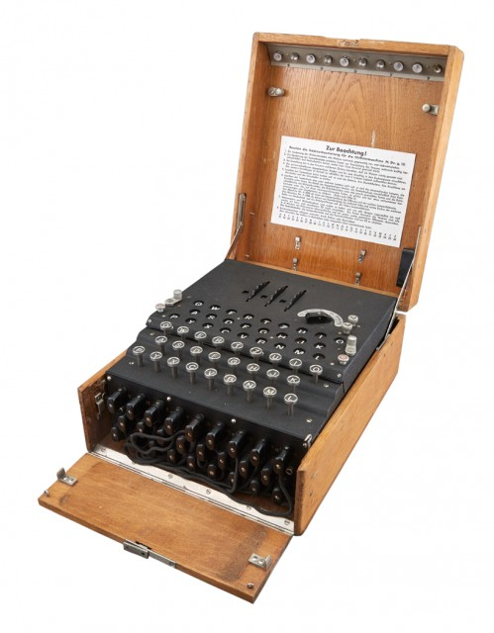
INFORMATION SECUIRITY - History
Germans elaborated the Enigma Machine. Important messages were sent by this encryption method. The Enigma machine was decrypted by a team of codebreakers at Bletchley Park in England during World War II. This team, which included Alan Turing, Marian Rejewski, and others, developed methods for breaking the encryption used by the Enigma machine. Turing played a particularly important role in the development of these methods, including the creation of the Bombe machine, which was used to automate the process of breaking Enigma messages. The work of these codebreakers is believed to have shortened the war by several years and saved countless lives.
ILIA STATE UNIVERSITY
Enigma

Slide 10
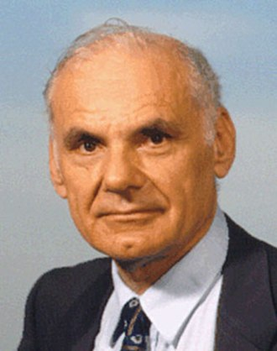
INFORMATION SECUIRITY - History
The Defense Advanced Research Projects Agency (DARPA) is a research and development agency of the United States Department of Defense responsible for the development of emerging technologies for use by the military. In 1968, the ARPANET project was formulated by Dr. Larry Roberts, which would later evolve into what is known as the internet. The main problems of arpanet was vulnerability of password structure and formats; lack of safety procedures for dial-up connections; and nonexistent user identification and authorizations", aside from the lack of controls and safeguards to keep data safe from unauthorized access. Hackers had effortless access to ARPANET, as phone numbers were known by the public.
ILIA STATE UNIVERSITY
Larry Roberts

Slide 11
Date | Documents
1968 | Maurice Wilkes discusses password security in Time-Sharing Computer Systems.
1973 | Schell, Downey, and Popek examine the need for additional security in military systems in “Preliminary Notes on the Design of Secure Military Computer Systems.”
1975 | The Federal Information Processing Standards (FIPS) examines Digital Encryption Standard (DES) in the Federal Register.
1978 | Bisbey and Hollingworth publish their study “Protection Analysis: Final Report,” discussing the Protection Analysis project created by ARPA to better understand the vulnerabilities of operating system security and examine the possibility of automated vulnerability detection techniques in existing system software.
1979 | Morris and Thompson author “Password Security: A Case History,” published in the Communications of the Association for Computing Machinery (ACM). The paper examines the history of a design for a password security scheme on a remotely accessed, time-sharing system.
1979 | Dennis Ritchie publishes “On the Security of UNIX” and “Protection of Data File Contents,” discussing secure user IDs and secure group IDs, and the problems inherent in the systems.
1984 | Grampp and Morris write “UNIX Operating System Security.” In this report, the authors examine four “important handles to computer security”: physical control of premises and computer facilities, management commitment to security objectives, education of employees, and administrative procedures aimed at increased security.
1984 | Reeds and Weinberger publish “File Security and the UNIX System Crypt Command.” Their premise was: “No technique can be secure against wiretapping or its equivalent on the computer. Therefore no technique can be secure against the systems administrator or other privileged users … the naive user has no chance.”
1968 | Maurice Wilkes discusses password security in Time-Sharing Computer Systems.
1973 | Schell, Downey, and Popek examine the need for additional security in military systems in “Preliminary Notes on the Design of Secure Military Computer Systems.”
1975 | The Federal Information Processing Standards (FIPS) examines Digital Encryption Standard (DES) in the Federal Register.
1978 | Bisbey and Hollingworth publish their study “Protection Analysis: Final Report,” discussing the Protection Analysis project created by ARPA to better understand the vulnerabilities of operating system security and examine the possibility of automated vulnerability detection techniques in existing system software.
ILIA STATE UNIVERSITY

Slide 12
INFORMATION SECUIRITY - History
Today, the Internet brings millions of unsecured computer networks into continuous communication with each other. The security of each computer’s stored information is now contingent on the level of security of every other computer to which it is connected. Recent years have seen a growing awareness of the need to improve information security, as well as a realization that information security is important to national defense. The growing threat of cyber attacks have made governments and companies more aware of the need to defend the computer-controlled control systems of utilities and other critical infrastructure. There is also growing concern about nation-states engaging in information warfare, and the possibility that business and personal information systems could become casualties if they are undefended.
ILIA STATE UNIVERSITY

Slide 13
MAIN AREAS of CYBERSECUIRITY
Software
Hardware
Data
Network
People
Procedures
ILIA STATE UNIVERSITY

Slide 14
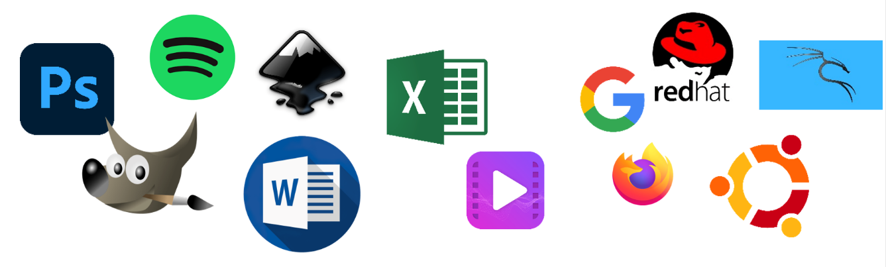
SOFTWARE
The software component of the IS comprises applications, operating systems, and assorted command utilities. Software is perhaps the most difficult IS component to secure. The exploitation of errors in software programming accounts for a substantial portion of the attacks on information. The information technology industry is rife with reports warning of holes, bugs, weaknesses, or other fundamental problems in software. In fact, many facets of daily life are affected by buggy software, from smartphones that crash to flawed automotive control computers that lead to recalls.
ILIA STATE UNIVERSITY

Slide 15
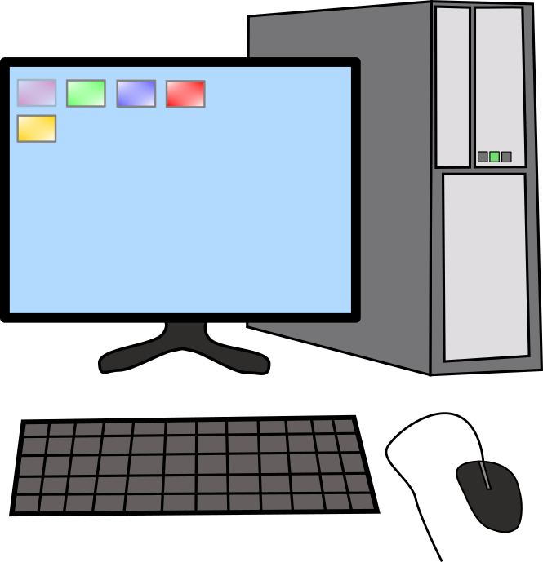
SOFTWARE SECURITY
The basic knowledge of programming is very useful to understand how program works and what kind of vulnerabilities can it contain.
Reverse engineering of software can be used in order to analyze it for viruses and potential vulnerabilities.
1 0 1 0 1 1 0 1 0 1 0 1 1 0 1 1 0 1 0 1 0 1 1 0 1 0 1 0 1 0 1 1 0 1 0 1 0 1 1 1 0 0 1 0 1 1 0 0 0 1
ILIA STATE UNIVERSITY

Slide 16
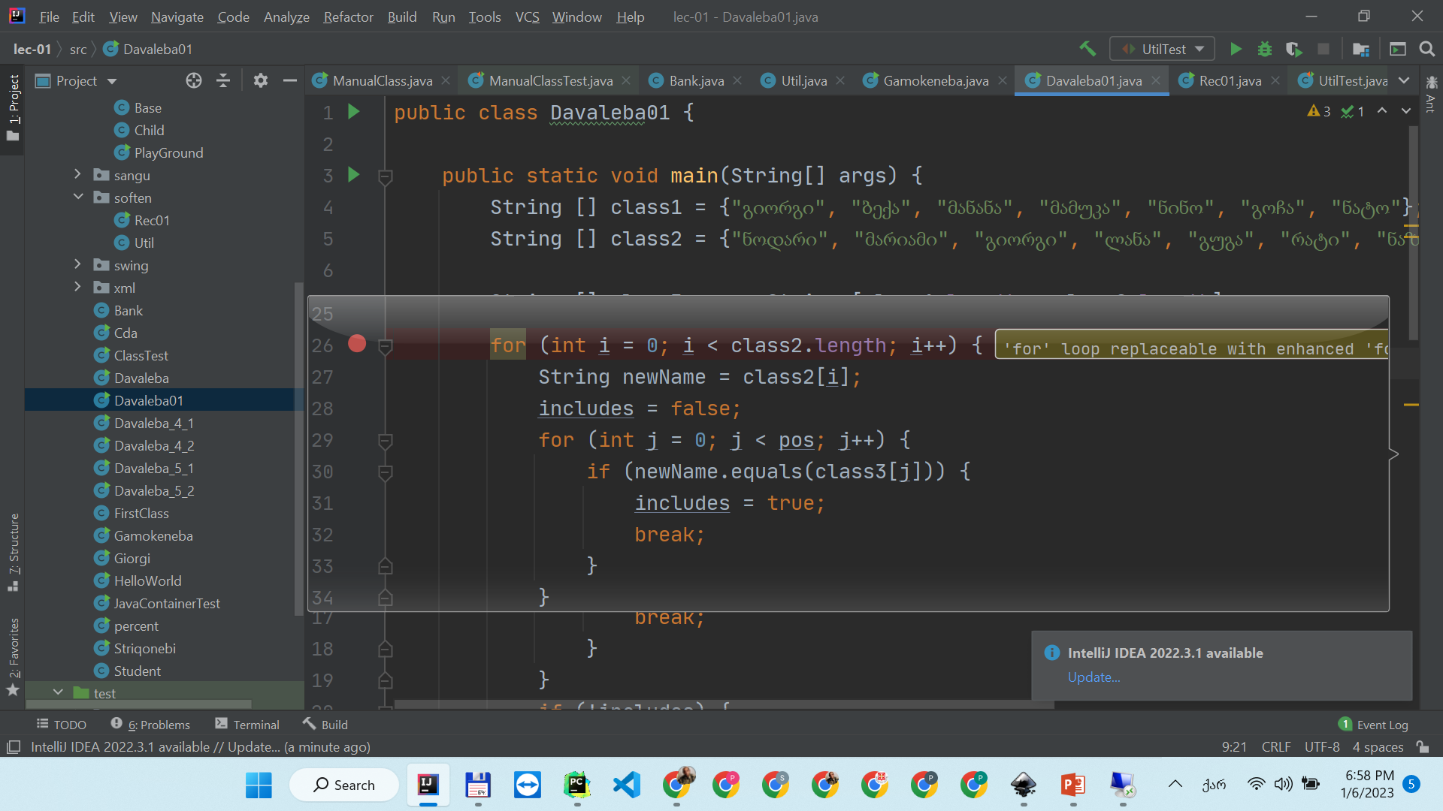
SOFTWARE SECURITY
ILIA STATE UNIVERSITY

Slide 17


SOFTWARE SECURITY
The worth thing we can do to get our favorite software:
ILIA STATE UNIVERSITY

Slide 18
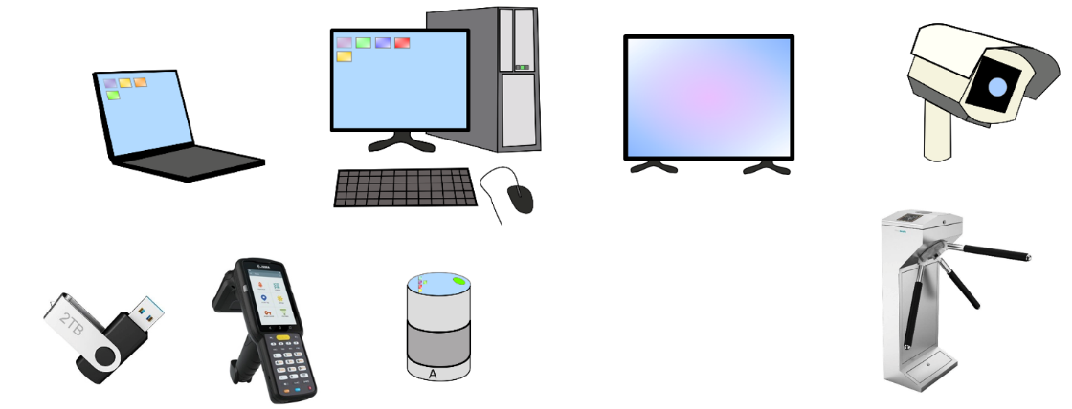
HARDWARE SECURITY
Hardware is the physical technology that houses and executes the software, stores and transports the data, and provides interfaces for the entry and removal of information from the system. Physical security policies deal with hardware as a physical asset and with the protection of physical assets from harm or theft.
ILIA STATE UNIVERSITY

Slide 19
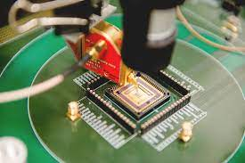
HARDWARE SECURITY
Hardware reverse engineering can be used to analyze potential vulnerabilities and bugs in micro chips.
ILIA STATE UNIVERSITY

Slide 20
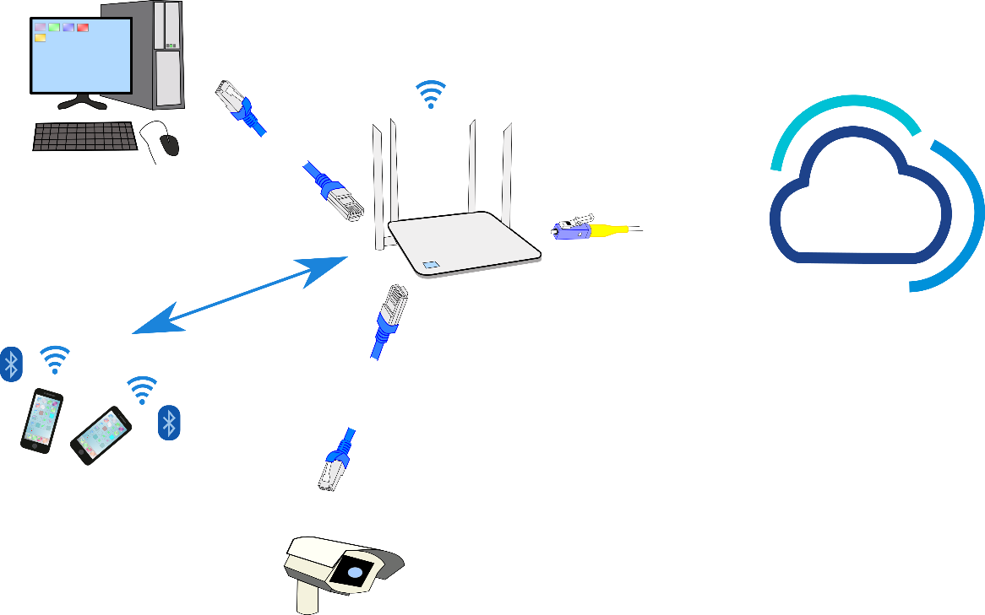
NETWORK SECURITY
The IS component that created much of the need for increased computer and information security is networking. When information systems are connected to each other to form local area networks (LANs), and these LANs are connected to other networks such as the Internet, new security challenges rapidly emerge.
ILIA STATE UNIVERSITY

Slide 21
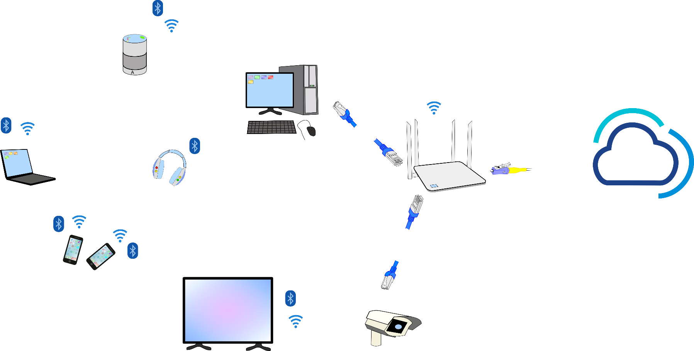
NETWORK SECURITY
Digital Assistant
Desktop
Laptop
Headphones
Router
ILIA STATE UNIVERSITY
Internet
TV
Mobile phones
Camera

Slide 22
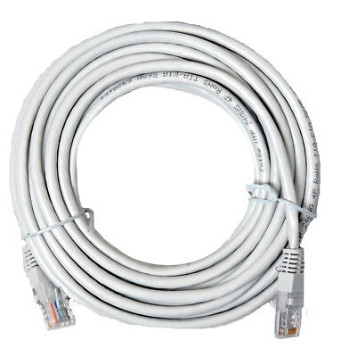

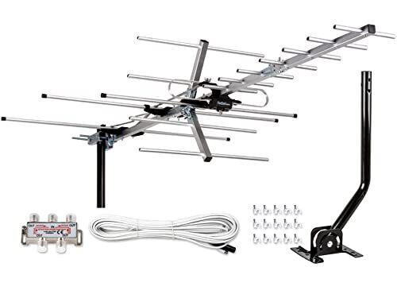

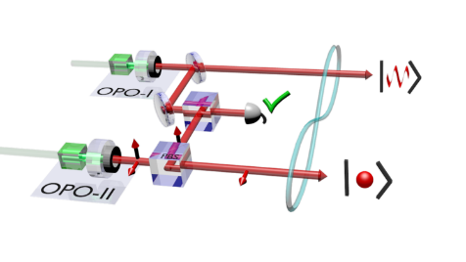
NETWORK SECURITY
Computers and other devices are connected to each other through a network. A network can be made up of different physical carriers
Electrical wire
ILIA STATE UNIVERSITY
Radio waves
Optical cable
Quantum connection

Slide 23
NETWORK SECURITY
There are number of network protocols. Different cybersecurity methods are needed to protect them.
MAC address: 90 2B FA 4F C1 17
IP address: 192.168.92.16
IP (v. 6) address : db8:3911:7BA4:C8AC:1DAED:64E3:4FFA
Domain name: iliauni.edu.ge
WEP, WPA, WPA2
SSL
DES, RSA, SHA
ILIA STATE UNIVERSITY

Slide 24
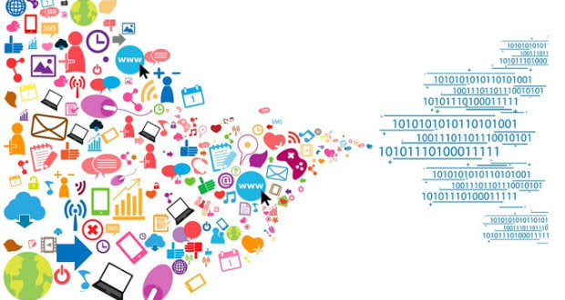
DATA SECURITY
ILIA STATE UNIVERSITY
Data stored, processed, and transmitted by a computer system must be protected. Data is often the most valuable asset possessed by an organization and it is the main target of intentional attacks.

Slide 25

PEOPLE SECURITY
Though often overlooked in computer security considerations, people have always been a threat to information security.
Georgian proverb: “ციხე ყოველთვის შიგნიდან ტყდებაო” - The castle is always got from the inside!
ILIA STATE UNIVERSITY

Slide 26

PROCEDURES SECURITY
Procedures are written instructions for accomplishing a specific task. When an unauthorized user obtains an organization’s procedures, this poses a threat to the integrity of the information.
ILIA STATE UNIVERSITY

Slide 27
TERMINOLOGY
ACTIVE THREAT
VULNERABILITY
RISK
ILIA STATE UNIVERSITY

Slide 28
ACTIVE THREAT
An active threat is a potential danger or hazard that is currently occurring or is likely to occur in the immediate future. In cybersecurity, an active threat refers to an ongoing attack on an information system, such as a virus or malware attack, a phishing attack, or a distributed denial of service (DDoS) attack.
ILIA STATE UNIVERSITY

Slide 29
VULNERABILITY
A vulnerability is a weakness or flaw in an information system that can be exploited by a threat actor to compromise the confidentiality, integrity, or availability of information. Vulnerabilities can be caused by a variety of factors, including software bugs, misconfigured systems, and user error.
ILIA STATE UNIVERSITY

Slide 30
RISK
In cybersecurity, risk refers to the likelihood that a threat actor will exploit a weakness in a system, and the potential impact of that exploitation.
When assessing risk, cybersecurity professionals typically consider several factors, including:
Threat likelihood: This refers to the probability of a threat actor successfully exploiting a weakness in a system. Cybersecurity professionals use threat intelligence and other sources of data to assess the likelihood of different types of attacks.
Asset value: This refers to the value of the system or data that is at risk. For example, a financial institution might consider their customer data and transaction systems to be high-value assets.
Potential impact: This refers to the potential consequences of a successful attack. For example, a successful ransomware attack could result in significant financial losses, reputational damage, and legal liabilities.
ILIA STATE UNIVERSITY

Slide 31
CIA
CIA is a commonly used acronym in information security that stands for Confidentiality, Integrity, and Availability. These are the three fundamental principles of information security that are used to ensure the protection of information.
Confidentiality: Confidentiality refers to the protection of information from unauthorized disclosure. This means that only authorized personnel should be able to access confidential information.
Integrity: Integrity refers to the protection of information from unauthorized modification. This means that information should be accurate and complete, and any changes to it should be made only by authorized personnel.
Availability: Availability refers to the protection of information from unauthorized disruption. This means that information should be available to authorized personnel when they need it.
ILIA STATE UNIVERSITY

Slide 32
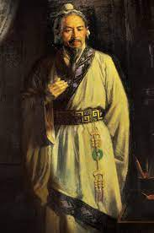
Risk Management
An observation made over 2,400 years ago by Chinese General Sun Tzu Wu has direct relevance to information security today.
If you know the enemy and know yourself, you need not fear the result of a hundred battles.
If you know yourself but not the enemy, for every victory gained you will also suffer a defeat.
If you know neither the enemy nor yourself, you will succumb in every battle.
ILIA STATE UNIVERSITY

Slide 33
Risk Management
Risk management is the process of identifying risk, as represented by vulnerabilities, to an organization’s information assets and infrastructure, and taking steps to reduce this risk to an acceptable level.
Each of the three elements in the C.I.A. triangle, is an essential part of every IT organization’s ability to sustain long-term competitiveness. When an organization depends on IT-based systems to remain viable, information security and the discipline of risk management must become an integral part of the economic basis for making business decisions. These decisions are based on trade-offs between the costs of applying information systems controls and the benefits realized from the operation of secured, available systems.
ILIA STATE UNIVERSITY

Slide 34
Risk Management
Risk management involves three major undertakings: risk identification, risk assessment, and risk control.
Risk identification is the examination and documentation of the security posture of an organization’s information technology and the risks it faces.
Risk assessment is the determination of the extent to which the organization’s information assets are exposed or at risk.
Risk control is the application of controls to reduce the risks to an organization’s data and information systems.
ILIA STATE UNIVERSITY

Slide 35
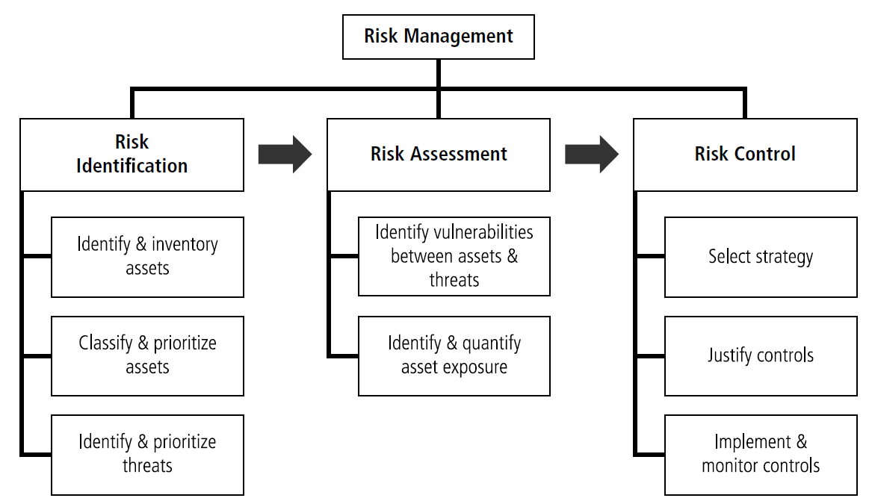
Risk Management
ILIA STATE UNIVERSITY

